Slide 1

7th Grade Math
Unit 13, Lesson 7 Representing Real-World Contexts with Graphs Volume 2, pg. 268

Slide 2


Benchmark
MA.7.DP.1.5
Given a real-world numerical or categorical data set, choose and create an appropriate graphical representation.
volume 2, pg. 268

Slide 3
Integrated Mathematical Thinking and Reasoning Standards
MA.K12.MTR.2.1 Demonstrate understanding by representing problems in multiple ways.
MA.K12.MTR.4.1 Engage in discussions that reflect on the mathematical thinking of self and others.
MA.K12.MTR.7.1 Apply mathematics to real-world contexts.
volume 2, pg. 268

Slide 4

Learning Target
I can choose an appropriate graphical representation for a real-world context.
volume 2, pg. 268

Slide 5

Warm-Up
volume 2, pg. 269

Slide 6
13.7.1 Warm-Up: Bell Work
To choose an appropriate graphical representation for data, the first step is to determine if the data is numerical (data points are numbers) or categorical (data points fall within categories).
volume 2, pg. 269

Slide 7
Complete the table. The first two rows have been completed.
Possible Question | Possible Responses | Numerical or Categorical
What is your favorite color? | red, orange, yellow, green | categorical numerical
How many people are in your family? | 2, 3, 4, 5… | categorical numerical
How old are you? | 11, 12, 13… | categorical numerical
How tall are you? |  | categorical numerical
What is your favorite sport? |  | categorical numerical
 | watermelon, apple, pear, orange | categorical numerical
volume 2, pg. 269

Slide 8

Exploration
volume 2, pg. 269

Slide 9

13.7.2 Exploration: Choosing the Best Graphical Representation for Numerical Data
Four graphical representations that can be used to display numerical data are box plots, histograms, line plots, and stem-and-leaf plots. Each graphical representation is shown in the table.
volume 2, pg. 269

Slide 10
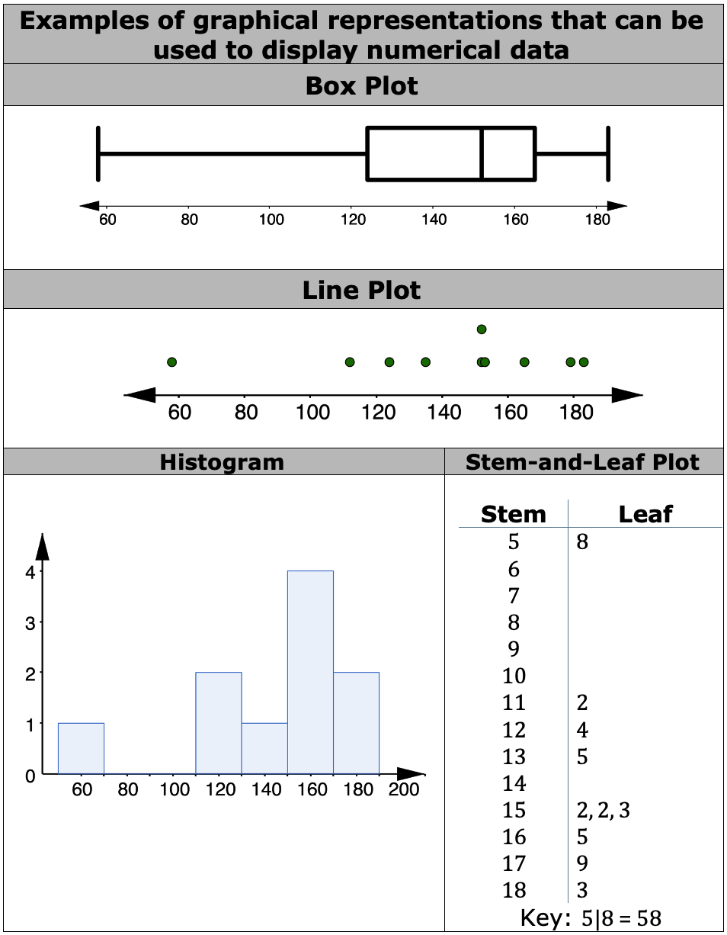
volume 2, pg. 269

Slide 11
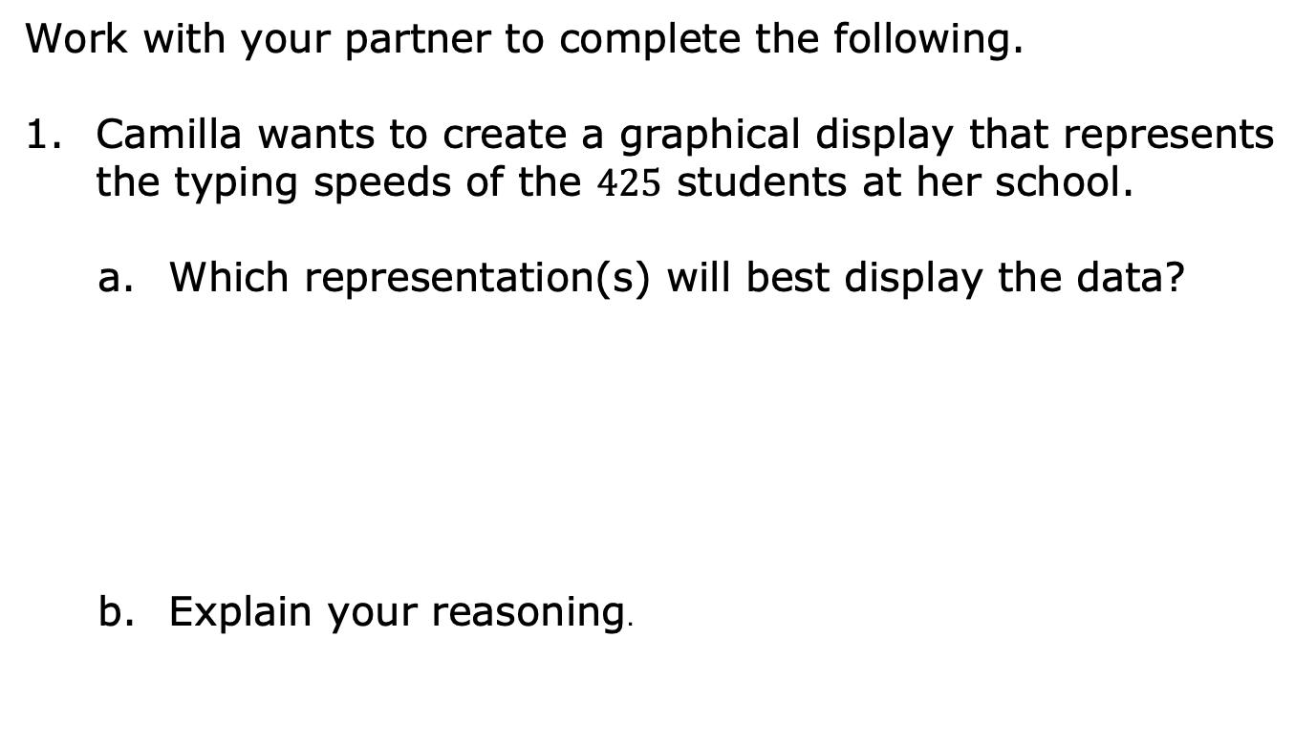
box plot
line plot
histogram
stem-and-leaf plot
volume 2, pg. 270

Slide 12
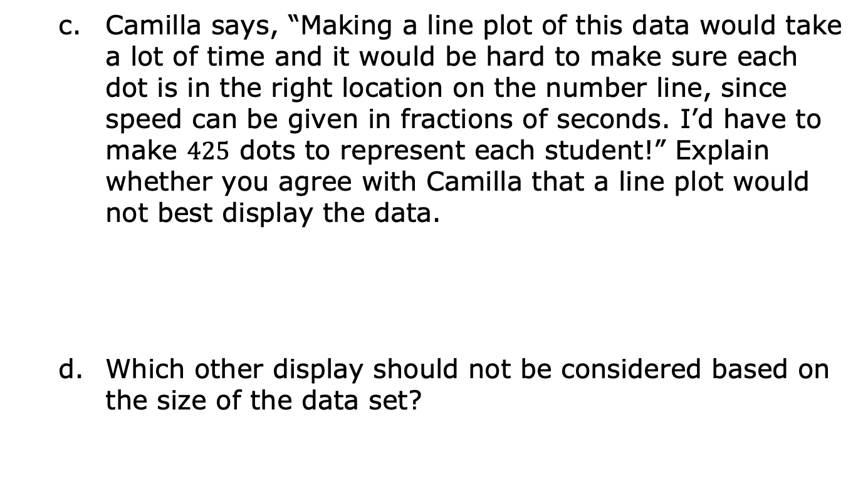
volume 2, pg. 270

Slide 13

Dallas records the highest temperature from each month over the past year in Immokalee, Florida.
Which representation(s) will best display the data?
Explain your reasoning.
box plot
line plot
histogram
stem-and-leaf plot
volume 2, pg. 270

Slide 14
Dallas decides to change his data set to the average weekly high temperature. Explain whether this changes the display he should use.
volume 2, pg. 270

Slide 15
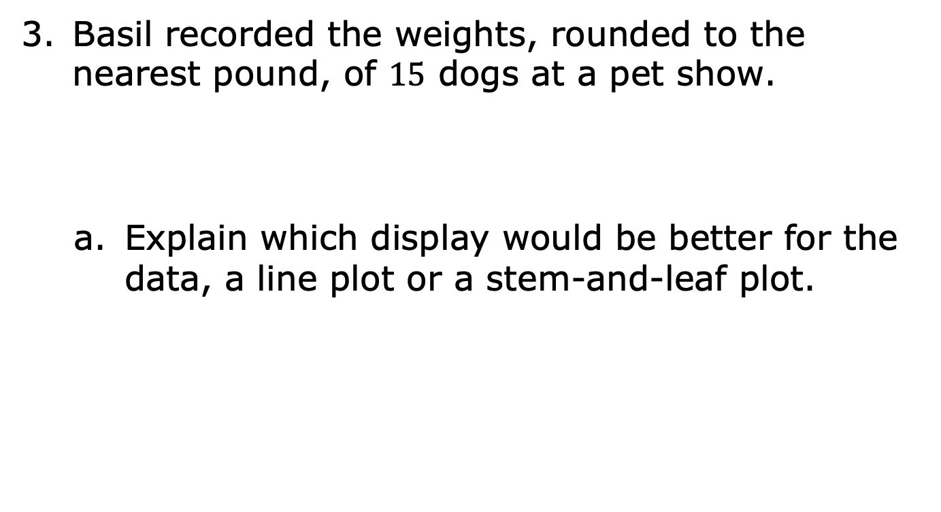
volume 2, pg. 271

Slide 16
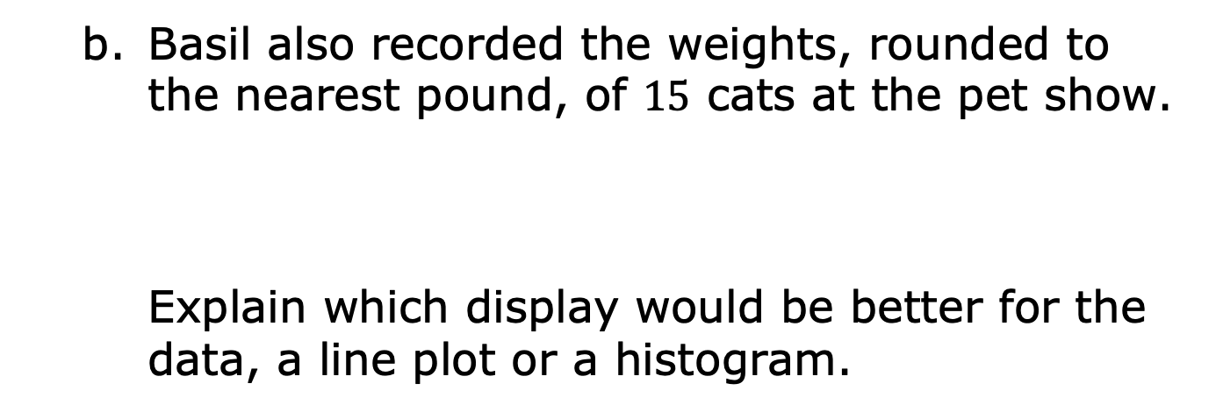
volume 2, pg. 271

Slide 17
Basil updated his data to show the weights of the cats to the nearest tenth.
Explain which display would be better for the data, a line plot or a histogram. If your recommendation is different from Part B, explain why.
volume 2, pg. 271

Slide 18
Ms. Rallen asked her students how many pets they each have and wants to use a graphical representation that will allow her students to see the overall shape of the data and give them enough information to calculate the 5-number summary.
Which graphical representation(s) should Ms. Rallen consider?
Explain your reasoning.
box plot
line plot
histogram
stem-and-leaf plot
volume 2, pg. 271

Slide 19

Bring It Together
volume 2, pg. 272

Slide 20


13.7.3 Bring It Together: Choosing the Best Graphical Representation for Numerical Data
Line plots are best for smaller sets of data and when the goal is to see each value over a scale, making it easier to calculate measures of center and spread.
Histograms are best for larger sets of data, data over a large range, or continuous data. One disadvantage is that the display cannot be used to calculate measures of center and spread since individual values cannot be determined from the display.
volume 2, pg. 272

Slide 21
Stem-and-leaf plots are helpful in visualizing the shape of a distribution, while still being able to see the individual values.
Box plots are helpful in visualizing the shape of a distribution and quickly identifying the five-number summary. This display cannot be used to find the mean.
volume 2, pg. 272

Slide 22

Guided Instruction
volume 2, pg. 272

Slide 23

13.7.4 Guided Instruction: Graphical Representations for Categorical Data
Two graphical representations that can be used to display categorical data are bar graphs and circle graphs.
A bar graph is a visual display of categorical data values where each category is represented by a bar whose height represents the number in that category. Bar graphs can be represented vertically or horizontally.
volume 2, pg. 272

Slide 24
The vertical bar graph shows data collected from a survey on how students get to school.
Number of Students
Transportation Type
volume 2, pg. 272

Slide 25
The same data is also displayed in a horizontal bar graph.
Number of Students
volume 2, pg. 273

Slide 26
A circle graph is a visual display of categorical data. The whole set of data is represented by the circle and its interior. The categories are represented by fractional parts of the circle. This is also called a pie chart.
volume 2, pg. 273

Slide 27
The circle graph below shows the same data.
volume 2, pg. 273

Slide 28
Complete the statements.
The bar graph visually shows
The circle graph shows
how each part relates to the whole.
how each part compares to the other parts.
how each part relates to the whole.
how each part compares to the other parts.
volume 2, pg. 273

Slide 29
Greer wants to convince the head chef at his school to include oat milk as an option at meals, so he asks a random sample of students from his school what their favorite kind of milk is: dairy, oat, or soy. He wants to use a graphical representation that makes it easy to compare the number of students who prefer oat milk to the total number of students surveyed.
volume 2, pg. 274

Slide 30
Jordan asks a random sample of students from his middle school which of these apps is their favorite: TikTok, Snapchat, Instagram, Pinterest, YouTube, WhatsApp, Kik, or Discord. He wants to display the data so it is easy to compare the different categories to each other.
volume 2, pg. 274

Slide 31
Complete each statement.
should use a bar graph. A bar graph is
the best option for this student because it
should use a circle graph. A circle
graph is the best option for this student because it
Greer
Jordan
visually shows how each part relates to the whole.
visually shows how each part compares to the other parts.
Greer
Jordan
visually shows how each part relates to the whole.
visually shows how each part compares to the other parts.
volume 2, pg. 274

Slide 32

Your Turn
volume 2, pg. 274

Slide 33
13.7.5 Your Turn!
Mr. Shapiro’s seventh grade class read more books than any other class in the middle school over the summer. The number of books read by the students in his class is shown below.
He wants to make a graph that shows the number of books read by each student. Which graphical representation would you recommend for this situation? Explain your reasoning.
{1, 1, 3, 5, 5, 6, 6, 6, 6, 7, 8, 9, 10, 10, 11, 12, 12,
14, 14, 15, 15, 15, 17, 17, 20, 23, 25, 27}
volume 2, pg. 274

Slide 34
Kendrick wants to make a graph that will show what proportion of students in his homeroom like science class best when compared to language arts, math, and social studies. Explain which graphical representation would best show this comparison.
volume 2, pg. 274

Slide 35

Wrap-Up
volume 2, pg. 275

Slide 36
13.7.6 Wrap-Up: Growth Mindset
Every mistake a person makes, their brain actually grows! Take a moment to celebrate your mistakes by summarizing your favorite mistake from today.
My favorite mistake from today was…
volume 2, pg. 275

